Slide 1
“Teach A Level Maths”
Statistics 1
Arranging and Choosing
© Christine Crisp

Slide 2
Statistics 1
AQA
MEI/OCR
OCR
"Certain images and/or photos on this presentation are the copyrighted property of JupiterImages and are being used with permission under license. These images and/or photos may not be copied or downloaded without permission from JupiterImages"

Slide 3
Suppose I want to arrange 5 different items in a row. How many ways can I do this?
We’ll label them ABCDE.
The 1st can be any one of the 5.
As one letter has been used, the 2nd can only be one of 4.
A
AB
AC
AD
AE
B
BA
BC
BD
BE
So far, the number of arrangements is 5 × 4
C
CA
CB
CD
CE
( We leave it in this form as it will be easier to spot a pattern. )
D
DA
DB
DC
DE
E
EA
EB
EC
ED
How many are there to choose from for the 3rd letter? How many arrangements does this give?

Slide 4

For EACH of the 5 × 4 arrangements of 2 letters, the 3rd can be one of 3 different letters . . .
e.g.
A
AB
ABC
ABD
ABE
AC
ACB
ACD
ACE
AD
ADB
ADC
ADE
AE
AEB
AEC
AED
. . . giving 5 × 4 × 3 arrangements.
For the 4th letter we have 2 possibilities, giving 5 × 4 × 3 × 2,
and for the 5th, 1 possibility giving 5 × 4 × 3 × 2 × 1.
5 × 4 × 3 × 2 × 1 is written as 5 ! and read as “ 5 factorial ”
Use the factorial function on your calculator to evaluate 5 !

Slide 5
The number of arrangements of 5 different items is
5 × 4 × 3 × 2 × 1 or 5!
Suppose we now want to know how many arrangements there are of only 3 of the 5 items.
We just stop a bit sooner, giving
5 × 4 × 3
What is the expression that gives the number of ways of arranging 4 different items out of 11?
ANS: 11 × 10 × 9 × 8

Slide 6
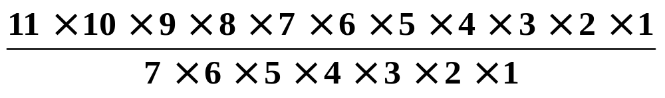
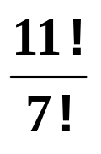
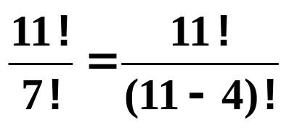
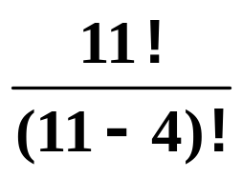
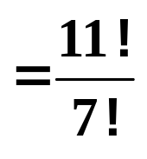
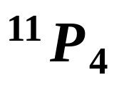
11 × 10 × 9 × 8 can be written as
or,
But,
So, the number of arrangements of 4 items from 11 ( all different ) is
This is sometimes written as where P stands for permutations, the technical word for arrangements.
The value of can be found from your calculator.

Slide 7
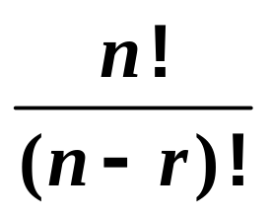
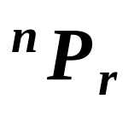
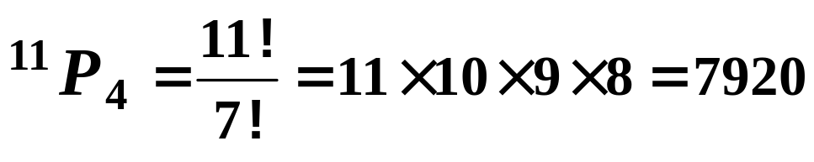

In general, if we have n different items, the number of arrangements of r of them in a line is given by
or
e.g. The number of arrangements of 4 items from 11 is given by
N.B. can be evaluated directly from a calculator.

Slide 8

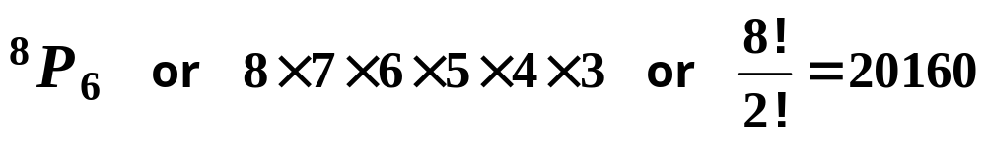
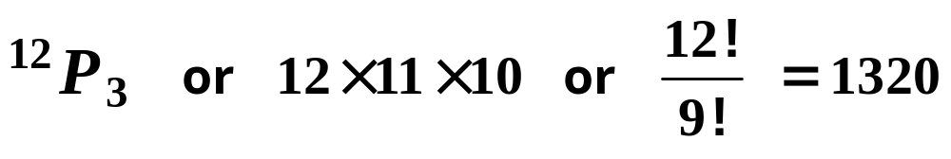
Exercise
1. The following numbers of different items are arranged in a line. Write down an expression for the number of possible arrangements and use a calculator to evaluate it.
(a) 6
(b) 12
2. The following numbers of different items are arranged in a line. Write down at least 2 ways of expressing the number of possible arrangements and use a calculator to evaluate them.
(a) 6 out of 8
(b) 3 out of 12
ANS:
1(a) 6 ! = 720 (b) 12 ! = 479001600
2(a)
2(b)

Slide 9
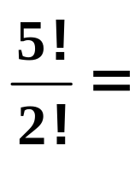


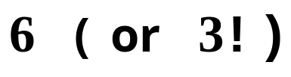
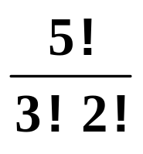
Now let’s go back to the 5 letters we started with:
ABCDE
The number of arrangements of 3 of them is
Now suppose we just want to choose 3 letters and we don’t mind about the order.
So, for example,
BDE,
BED,
DBE,
DEB,
EBD,
EDB,
count as one choice ( not 6 as in the arrangements ).
To get the number of different choices we must divide by the number of ways we can arrange each choice i.e.
we must divide by
The number of ways we can choose 3 items from 5 is

Slide 10
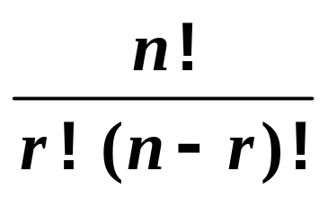
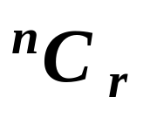
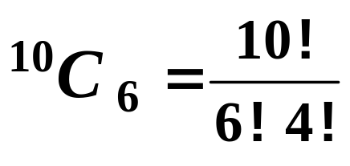
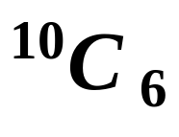
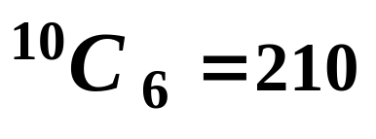
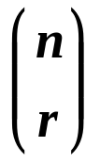
In general, if we have n different items, the number of choices of r of them at a time is given by
or
The C stands for combinations, the technical word for choices but I just think of it as “choose”.
e.g.
is read as “ 10 choose 6 ”
and is the number of ways of choosing 6 items from 10.
Find the value of using the function on your calculator.
ANS:
The notation is also sometimes used.

Slide 11
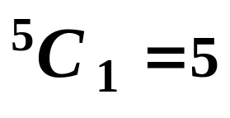
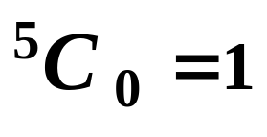
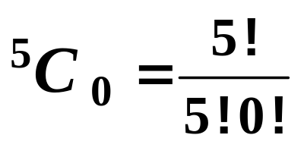
Some Special Values
Suppose we throw a die 5 times and we want to know in how many ways we can get 1 six. The possibilities are
6 6/ 6/ 6/ 6/
( a six followed by 4 numbers that aren’t sixes. )
6/ 6 6/ 6/ 6/
So,
6/ 6/ 6 6/ 6/
6/ 6/ 6/ 6 6/
There are 5 ways of getting one six.
6/ 6/ 6/ 6/ 6
There is only 1 way of getting no sixes:
6/ 6/ 6/ 6/ 6/
So,
However,
So, we must define 0! as 1

Slide 12
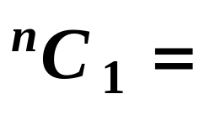

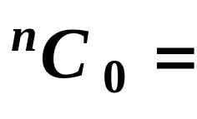

In general,
and 0 ! is defined as 1

Slide 13
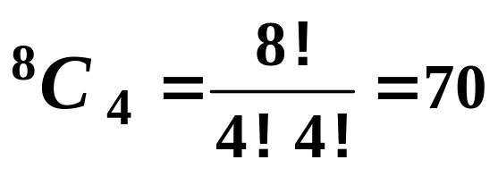
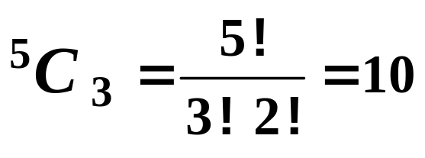
Exercise
1. A team of 4 is chosen at random from a group of 8 students. In how many ways can the team be chosen?
2. 5 boxes are in a line on a table. As part of a magic trick, a card is to be placed in each of 3 boxes. In how many ways can the boxes be chosen?
ANS:
1.
2.

Slide 14


Slide 15
The following slides contain repeats of information on earlier slides, shown without colour, so that they can be printed and photocopied.
For most purposes the slides can be printed as “Handouts” with up to 6 slides per sheet.

Slide 16
In general, if we have n different items, the number of arrangements of r of them in a line is given by
or
e.g. The number of arrangements of 4 items from 11 is given by
N.B. can be evaluated directly from a calculator.

Slide 17
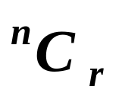
In general, if we have n different items, the number of choices of r of them at a time is given by
or
The C stands for combinations, the technical word for choices but I just think of it as “choose”.
e.g.
is read as “ 10 choose 6 ”
and is the number of ways of choosing 6 items from 10.
N.B. can be evaluated directly from a calculator.
The notation is also sometimes used.

Slide 18
In general,
and 0 ! is defined as 1

